Slide 1

MIS 6308 SEC003-89049
GROUP NO 7
OPTIC LINK
Aditi Jaiswal
Kruthagama Divakar
Malav Shah
Monica Vittal
Ashitosh Bhinge

Slide 2
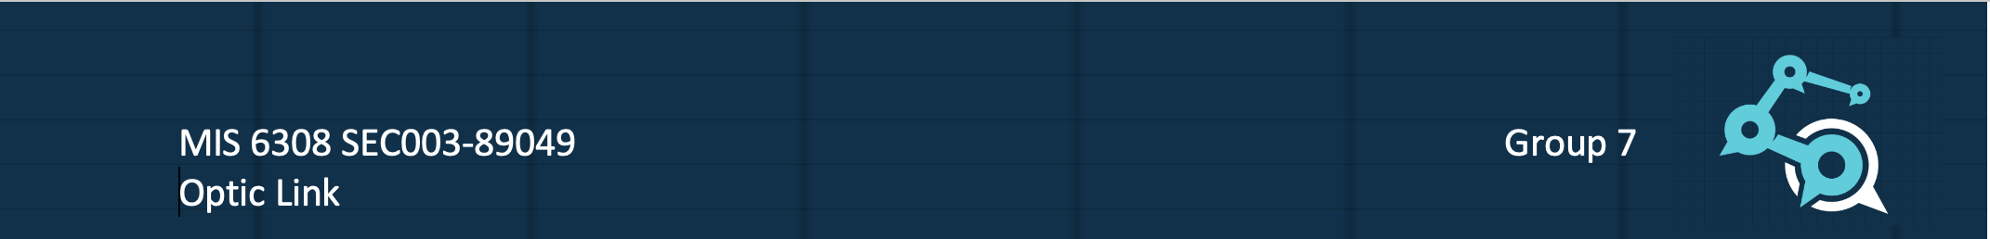
Problem Statement
Every clinic and hospital in Columbia Asia that does retina scans and measurements currently employs a separate registration system, imaging system, software, and database that eventually connects to the hospital’s primary electronic medical record (EMR) system and central database.
Due to the lack of integration between the separate device software and EPIC, doctors can only view patient files from specific locations.
The multilayered overall system results in affecting data integrity and availability. Moreover, the extensive dependencies have made the system unstable.

Slide 3
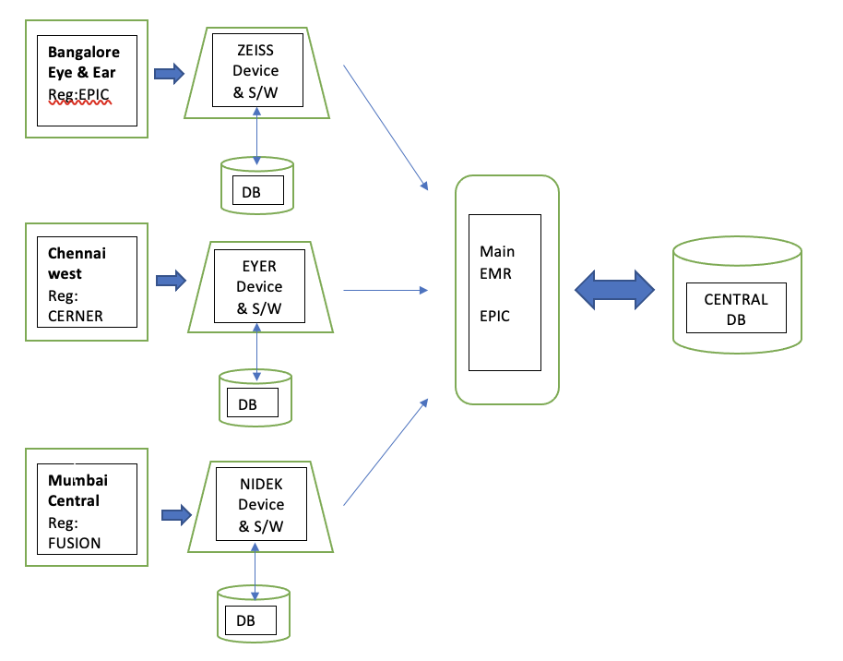
AS-IS ANALYSIS

Slide 4
Objective
Through IoT, database consolidation, system integration, and the development of a new web-based application for simple accessibility, this project is focused on improving the workflow of the ophthalmology department at the Columbia Asia Group.
This project aims to achieve improved access, experience and outcome.
Access: Patients and doctors are vital stakeholders in the healthcare system. We aim to provide convenient access to the system. Therefore, we digitize the whole ecosystem of hospitals and record-keeping storage, resulting in access from anywhere and anytime.
Experience: Aims to provide a seamless patient experience starting from reception to discharge.

Slide 5
Scope
The fundamental objective of OPTIC LINK is to establish a single point for data collection, and preliminary storage and to facilitate data flow into the hospital's central database.
The components of this project are:
Use OPTIC LINK's Facial Recognition feature, enabled by ML algorithm, to register and identify patients, instead of the location-specific registration system.
Eliminate the need for discrete device-specific databases and connect all the devices, regardless of type and brand to OPTIC LINK’s cloud, using NAS (Network Attached Storage).
Utilize OPTIC LINKS interactive UI which facilitates easy navigation between examination and images and has tools for clinical analytics and business intelligence.
Integrate OPTIC LINK with the hospital's Central Database and EMR for ease of access.
Migrate Historical data into OPTIC-LINK’s Database.
Train Physicians and Hospital staff with the new application.

Slide 6
WBS
PROJECT PLANNING-
Develop WBS and understand the current system and work on change management- 3 days
ANALYSIS TASKS-
Meet with Hospital Administration to analyse the pain points- 2 weeks
Speak with patients to learn about their opinions on the current system- 2 weeks
Interact with technical staff for the existing devices- 2 days
Connect with development team and gather information for the new system- ½ day
Collaborate with the existing database and data administrators- ½ day
Track user activities and define new requirements- 1 day
DESIGN TASKS-
Create and design user flow and use cases- 2 days
Design Database Schema- 1 week
Design wireframes and access links- 2 days
Define hardware (camera and kiosk) requirement- 1 day

Slide 7
WBS
BUILD TASKS-
Database creation- 5 days
Integrate existing database with the new one- 3 days
Develop user interface for doctors and patients- 2 weeks
Hardware Installation- 4 days
Establish link between cloud and all the hardware devices- 2 days
Integrate database with front end- 1 day
Testing- 1 week
Resolve testing bugs and issues- 1 week
Deploy code in production environment- 1 day
Testing the real-time usage- 1 day
Resolve real-time issues- 1 day
Feedback from users on the product and future enhancements- Real time (continuous process)

Slide 8
Delivarables | Acceptance Criteria
Capture Patient Demographics for new patient registration | A new patient file is created in the Hospital Database and a unique MRN is assigned
Utilize the facial recognition software to check in patients for follow-up visits using IoT devices | Patient file is retrieved after matching facial features with internal records.
Store and navigate through Images and Measurements from multiple devices and locations | Hospital staff can access patient records from any hospital/clinic through the OPTIC LINK cloud
Merge any duplicate records into one single patient file | There is a unique patient file for every MRN
Generate standard HL7 messages and DICOM images to pass on to the main EMR | Data from each optical device is converted to the standard format accepted Hospital-wide

Slide 9
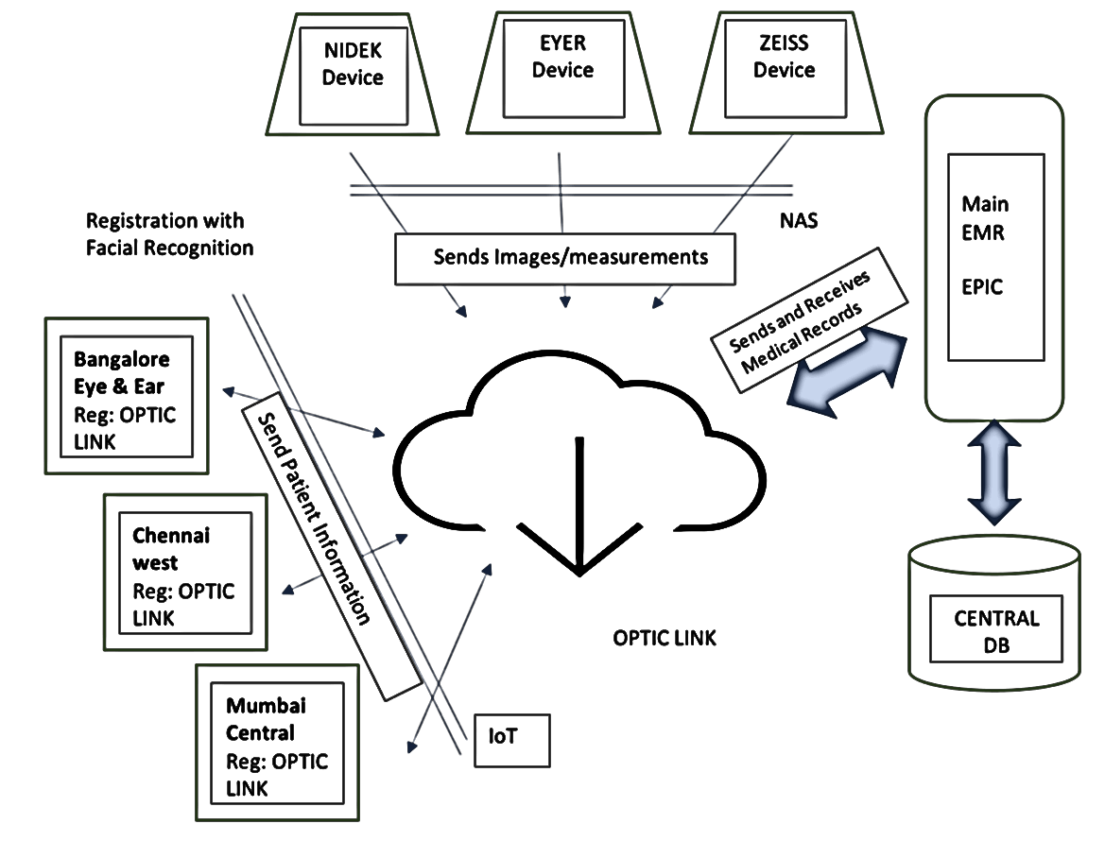
Proposed State

Slide 10
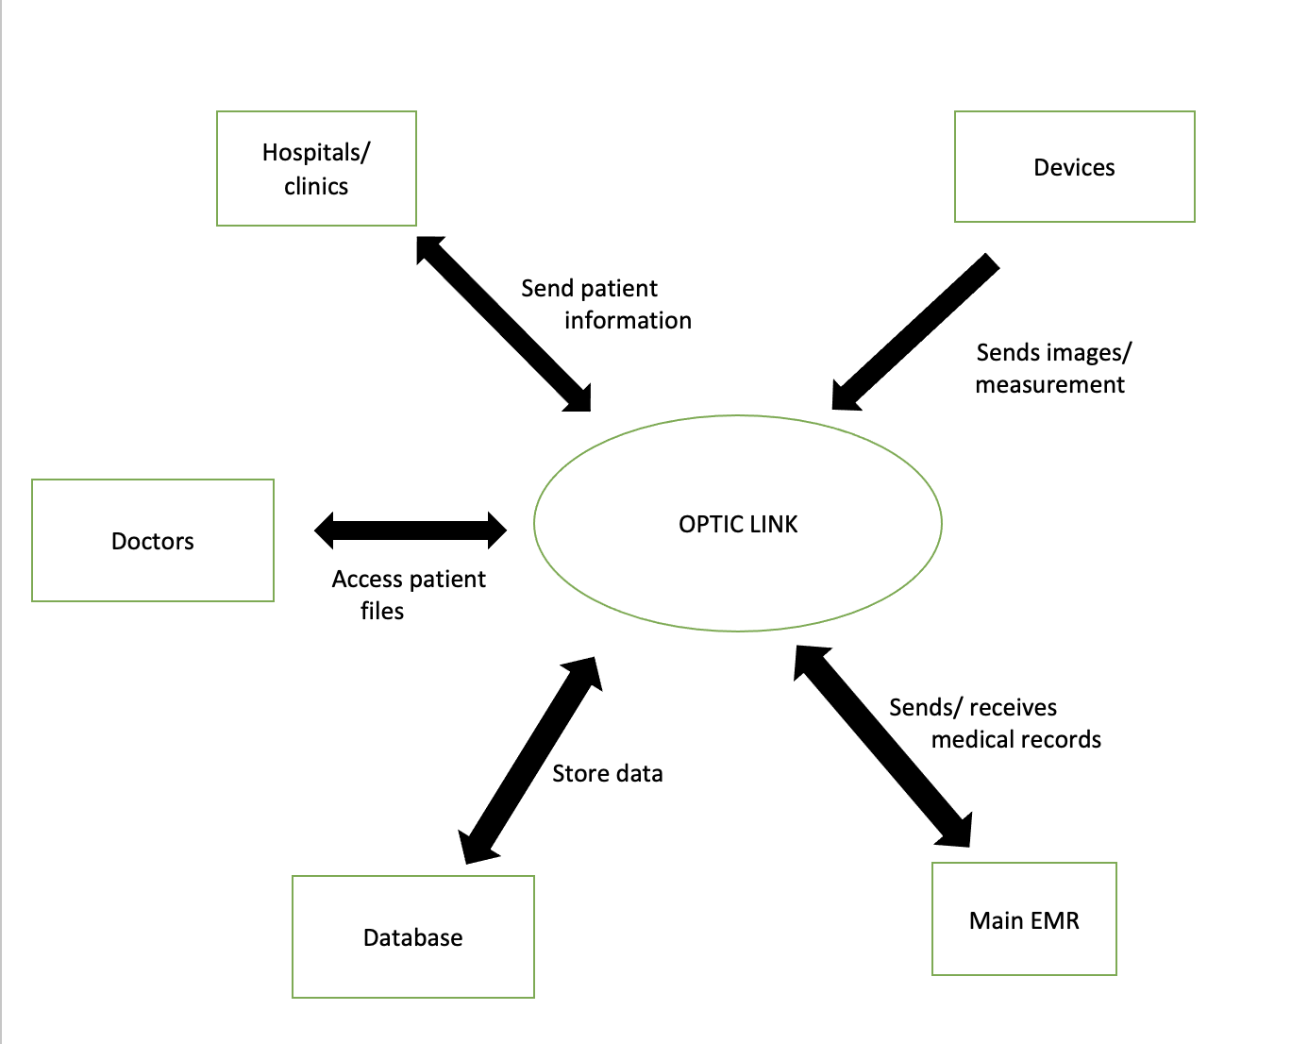
Context Diagram

Slide 11
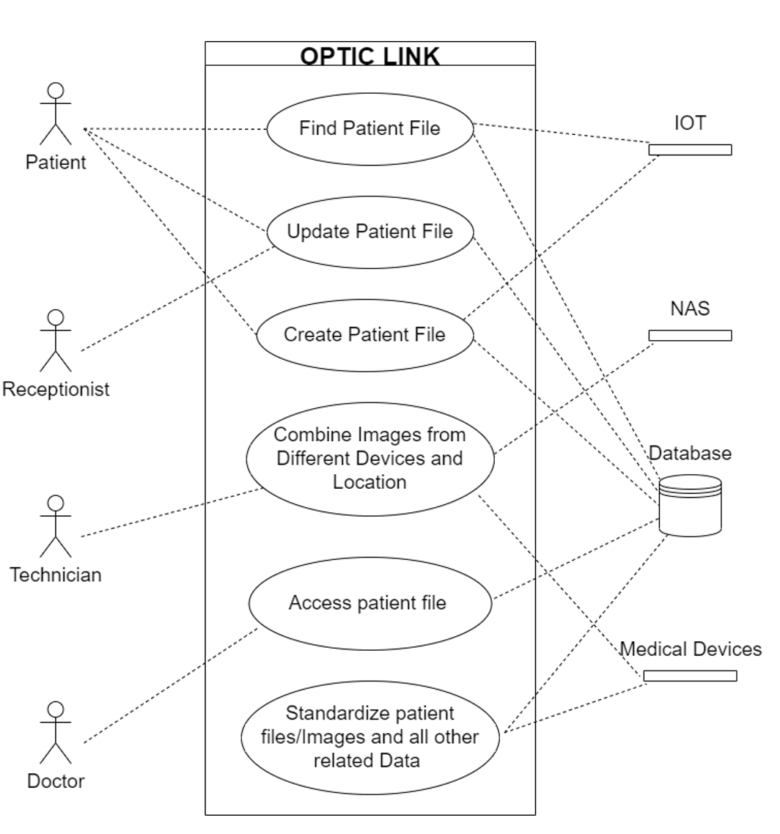
Use Case Diagram

Slide 12
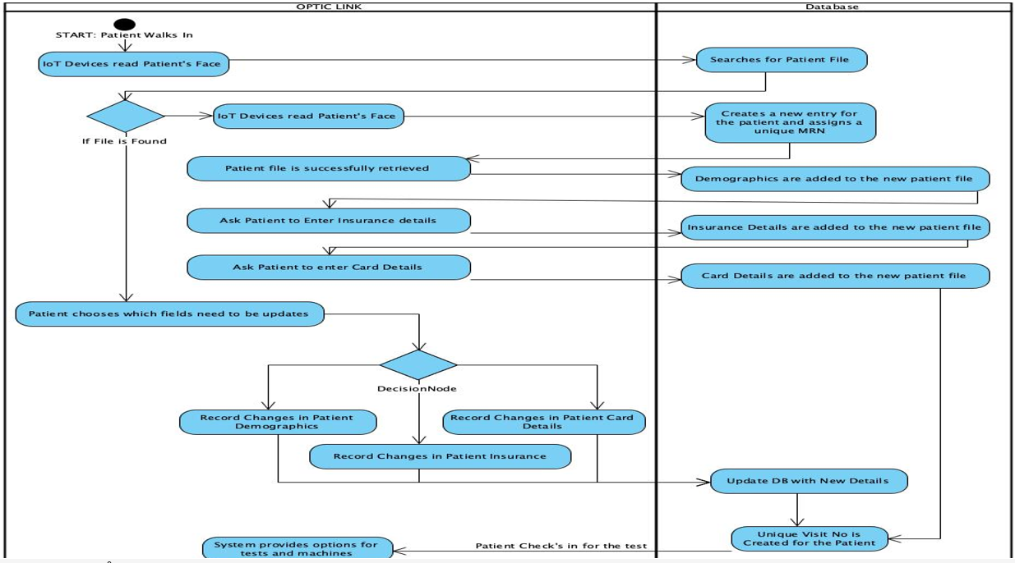
Activity Diagram

Slide 13
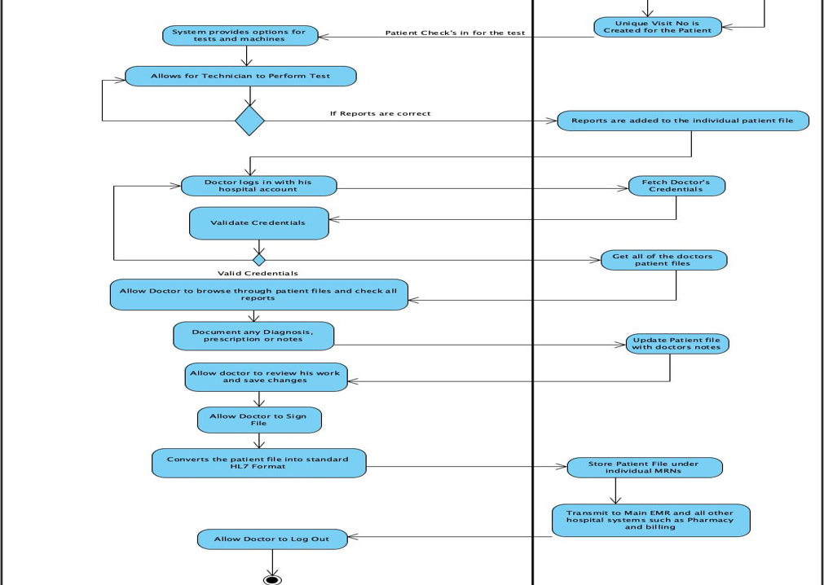
Activity Diagram

Slide 14
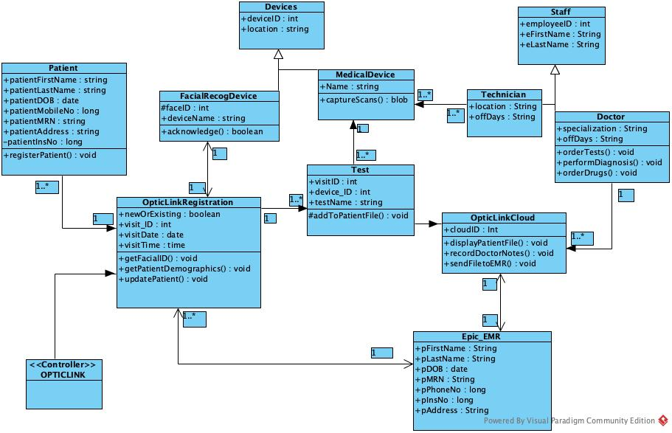
Class Diagram

Slide 15
Future Scope
Development of a Mobile application to access patient files for physicians and patients from OPTIC LINK.
Video consultation capabilities of OPTIC LINK for remote consultation.
Customizable Reports for internal audits.
Extend the functionality of OPTIC LINK to any other hospital department.

Slide 16
THANK YOU

